Slide 1
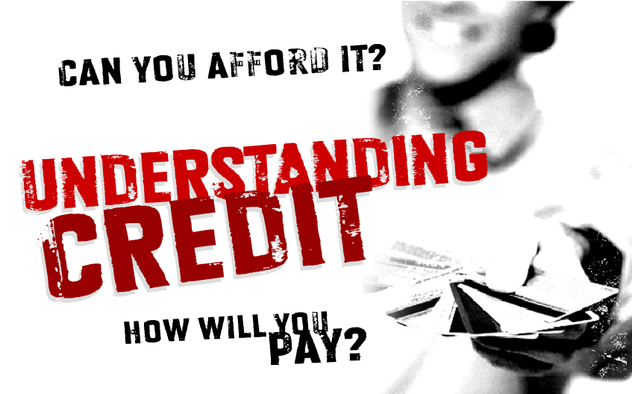
E1

Slide 2
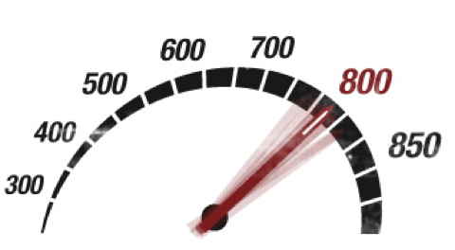
Your Credit Score
Everything you do with your credit accounts affects your credit score including car and school loan
Creditors extend credit to credit worthy customers
When you pay your bills on time, you are proving yourself credit worthy
Banks reward good customers with lower interest rate loans and higher credit lines
Employers may check your score. A bad score may result in fewer job offers
E2

Slide 3
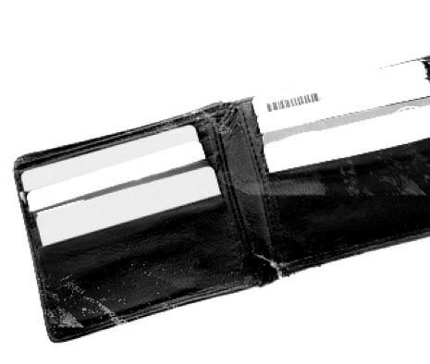
Knowing Your Limit
Don’t get in over your head. A credit card is a loan
Anything not paid back in full is assessed an interest charge.
There’s a pre-determined credit limit and money spent can be paid back in full or in installments.
E3

Slide 4
Understanding Interest Rates
Non-installment credit
Regular
30-day charge accounts (American Express)
Travel and entertainment cards
Installment credit
Car loan, student loan, home loan
Furniture purchase
Revolving credit
Department store cards
Bank cards: Visa/MasterCard
E4

Slide 5
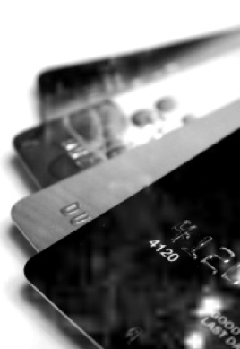
Advantages and Disadvantages
of Credit Offers and Options
Advantages:
Convenient
Immediate purchasing power
No need for cash
Bills can be consolidated
Zero liability on fraud
But remember…
It’s a loan
Interest rate may go up
May include additional fees
Can be easy to overspend
Can promote impulse buying
E5

Slide 6
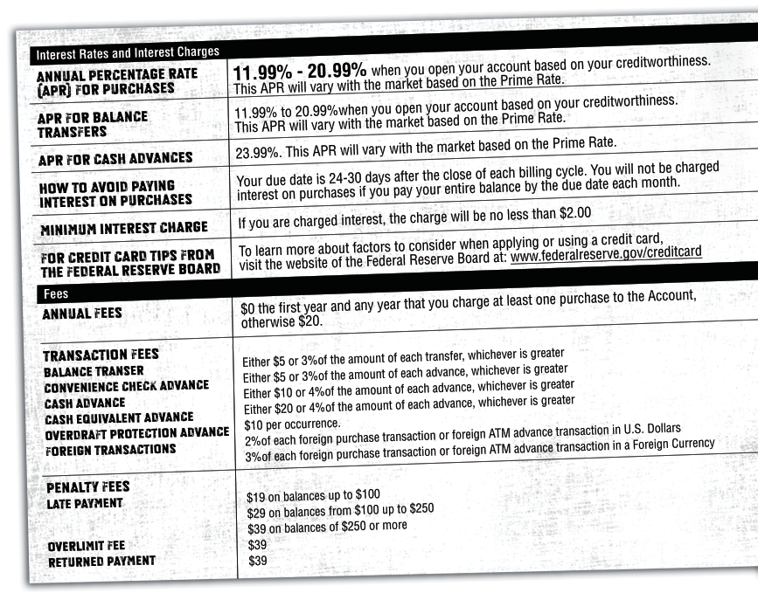
You’ll pay a higher APR for cash advances than you do for purchases.
Use the APR to help you compare the cost of different credit cards.
All of these fees are on top of any interest you might pay.
Annual Fees occur whether or not you use your card.
E6

Slide 7
Student Loans & Their Benefits
The advantages of credit show best when used with responsible forethought
Disadvantages show up when you don’t use your credit wisely
Bottom line, don’t sign up for credit you can’t afford
E7

Slide 8
Decoding Credit
Choosing the right card starts with comparison shopping
For more information visit:
www.BankRate.com
www.CreditCards.com
E8

Slide 9
CREDIT AND DEBT MANAGEMENT

Slide 10
CREDIT AND DEBT MANAGEMENT
10
Paying your credit card bill just a couple of days after the due date won't affect your credit report.
True or false?

Slide 11
CREDIT AND DEBT MANAGEMENT
11
All credit cards have the same grace period (also known as an interest-free period).
True or false?

Slide 12
CREDIT AND DEBT MANAGEMENT
12
Last month, your credit card balance was zero. This month, your statement shows that you made a $500 purchase. If you pay off $400 by the due date, you will be charged interest only on the $100 left to pay.
True or false?

Slide 13
CREDIT AND DEBT MANAGEMENT
13
If you use your credit card to take money out as a “cash advance,” you don’t have to pay interest on the amount you’ve withdrawn as long as you pay your credit card bill in full by the due date on your statement.
True or false?

Slide 14
CREDIT AND DEBT MANAGEMENT
Without a good credit history…
Your bank may charge you higher interest rates on a personal loan for a car, house, etc.
Your bank may refuse to give you a loan.
You might not be able to get a lease on an apartment.
A and B only.
All of the above.
14

Slide 15
CREDIT AND DEBT MANAGEMENT
How to stay out of trouble
Pay the balance in full each month.
If you can’t pay it in full, pay as much as you can.
Don’t make only the minimum payment.
If you always carry a balance, get a low-rate card.
Transfer the balance to a line of credit with a lower rate.
Pay a few days before the due date.
15

Slide 16
CREDIT AND DEBT MANAGEMENT
Minimum vs. fixed payments
Initial balance: $3,000
Interest rate: 18%
16

Slide 17
CREDIT AND DEBT MANAGEMENT
Tips for managing debt
Shop around.
Compare interest rates. Don’t accept your first offer.
Keep within your budget.
Borrow only what you can afford to pay back regularly and on time.
Pay back more and pay more often.
Additional payments mean you’ll pay it off sooner and pay less interest.
17

Slide 18
CREDIT AND DEBT MANAGEMENT
Canada Student Loans Program
For students in financial need.
Interest-free while you are enrolled in post-secondary education.
Become payable six months after you leave your studies.
Apply for this federal support through your provincial or territorial student assistance office.
For more information, visit www.canada.ca/jobs and click on Education.
18

Slide 19
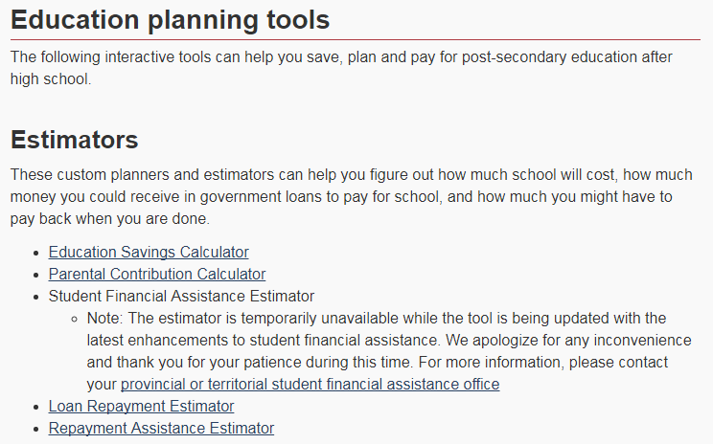
CREDIT AND DEBT MANAGEMENT
Prepare for the cost of university
19
For more information, visit www.canada.ca/money

Slide 20
CREDIT AND DEBT MANAGEMENT
Getting a copy of your credit report is:
A good way to check for identity theft.
The only way to know if your report is accurate.
Free of charge, if you request the report be sent to you by mail.
All of the above.
20

Slide 21
CREDIT AND DEBT MANAGEMENT
If you have applied for several credit cards or other forms of credit within a short period of time, this could have a negative impact on your credit score.
True or false?
21

Slide 22
CREDIT AND DEBT MANAGEMENT
Which of the following does not affect your credit score?
Your payment history – whether you have ever missed a debt payment.
Any collection of bankruptcy that has been recorded against you.
Your history of repaying informal loans from family or friends.
Any outstanding debts you have.
Your account history – how long you have had credit, and the type of credit you have.
22

Slide 23
CREDIT AND DEBT MANAGEMENT
Recognize the danger signals
You use your credit cards as a necessity instead of a convenience.
You use credit or cash advances for your daily living expenses.
You miss payments or due dates.
You’re near the credit limit on most of your cards.
You borrow from one card to pay another.
You transfer balances every few months just before the introductory offer expires.
23

Slide 24
PROTECTING YOURSELF

Slide 25
PROTECTING YOURSELF
Identity fraud statistics
In 2010:
More than $25 million was lost as a result of credit card fraud.
$119 million was stolen via debit card fraud.
In 2016:
Over 25,856 Canadians fell victim to identity fraud.
Average loss to identity fraud: $452.54.
25

Slide 26
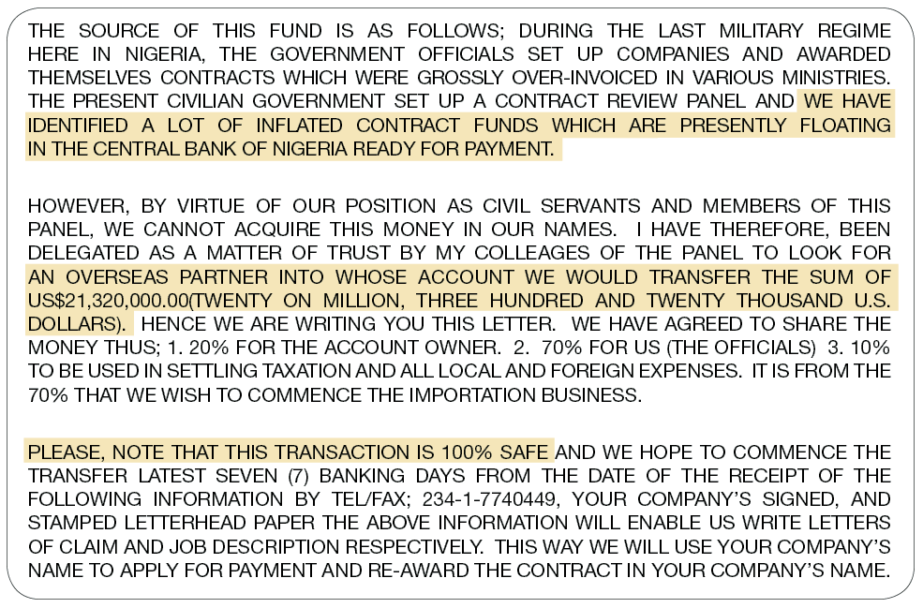
PROTECTING YOURSELF
Transfer of fund scam
26

Slide 27
PROTECTING YOURSELF
Lottery
scams
27

Slide 28
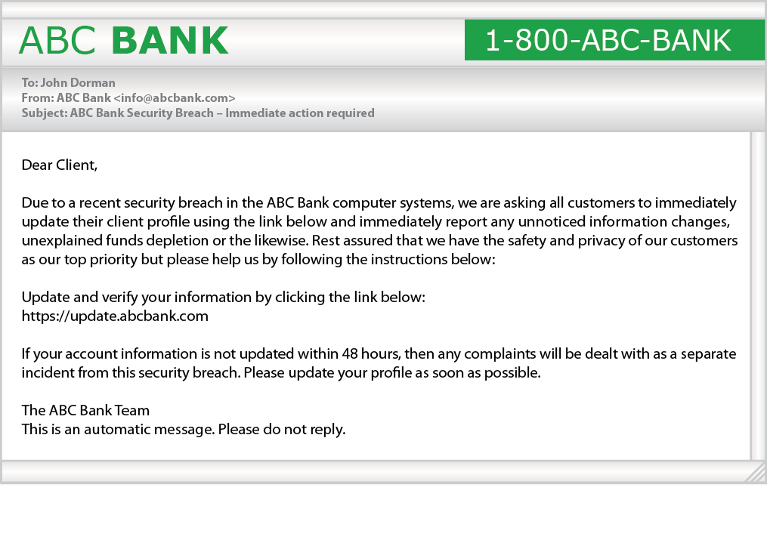
PROTECTING YOURSELF
Phishing emails and phony Web pages
28

Slide 29
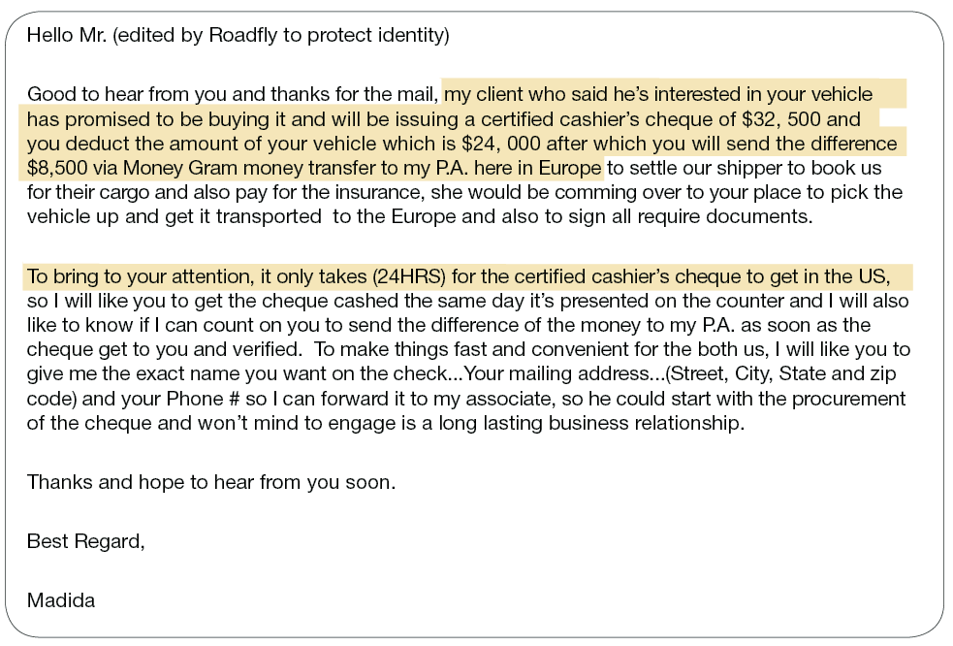
PROTECTING YOURSELF
Items for sale over-payment scam
29

Slide 30
PROTECTING YOURSELF
Signs of bogus job ads
Offer considerable pay with few to no duties.
Promise payment of wages in cash.
Contain no physical address or contact person.
Require you to open a new bank account or accept company cheques to “test” a wire transfer service.
30

Slide 31
PROTECTING YOURSELF
Protecting yourself
Don’t share personal information freely.
Destroy documents with personal information.
Keep your wallet or purse safe.
Don’t carry ID you don’t need (such as your SIN).
Lock your household mailbox if possible.
31

Slide 32
PROTECTING YOURSELF
Protecting yourself, cont.
Limit the number of credit cards you hold.
Check your credit report once a year.
Make sure websites are secure before transmitting personal information.
Delete emails that ask for personal information.
Keep computer firewalls and spyware up-to-date.
32

Slide 33
PROTECTING YOURSELF
Keep your computer passwords safe.
Don’t give telemarketers personal information.
Destroy old documents that contain identity information.
Be skeptical – if an offer sounds too good to be true, it is!
Save paper bank records for at least a year.
Protecting yourself, cont.
33

Slide 34
PROTECTING YOURSELF
What to do
Contact your financial institution immediately.
Notify Canada’s credit bureaus (Equifax Canada at www.equifax.ca and TransUnion Canada at www.transunion.ca).
Contact the Canadian Anti-Fraud Centre.
Notify your local police as soon as you are aware of it.
34

